Slide 1


K ickstarter Success
Project Demo
By Shenica r. Graham
Lambda School Student, WEBPT23
WEB Unit 1 Build, October 24, 2020

Slide 2


Introduction
Hi Sharks. Have you ever lost time and money on a failed fundraising campaign? First of all, subjecting yourself, your ideas, and your projects to public scrutiny can be a major stressor, not to mention how you would feel if you failed. Crowdfunding is a global reaching concept that is putting as many new projects on the map as it is creating new failures every day. Life after a failed project can be daunting even for the industrious. However, there is evidence that crowdfunding is a viable alternative to the conventional methods of the previous century that involve big banks and bigger interest rates. One of the crowdfunding gurus is Kickstarter. According to statista.com, about 17 million people have pledged monetary support of Kickstarter projects. However, Kickstarter reports that 11% of projects finish without ever receiving a single pledge. How can you know if a campaign is likely to fail before investing? You need an edge – a campaign success predictor. Welcome to Kickstarter Success!
By Shenica r. Graham

Slide 3
The Kickstarter Problem
Before I introduce the team, let’s look at the Kickstarter problem. Sure, the idea of raising unlimited funds for your project is inviting. However, the all-or-nothing model of Kickstarter means that if your goal is not met, you lose all pledges – even if you are very close to meeting your fundraising goal. This problem was important to our team because we felt that most campaigns were failing not because of a lack of effort, but because of other factors such as viability in terms of some campaign variables that we will address.
By Shenica r. Graham

Slide 4

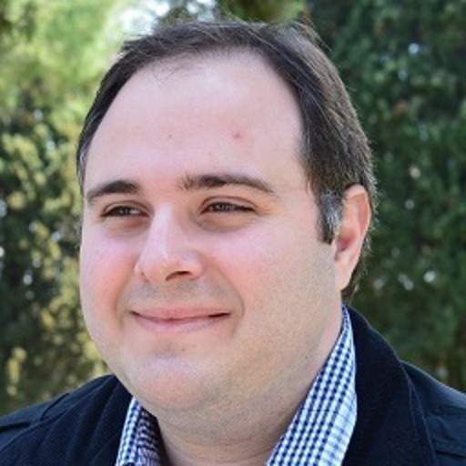



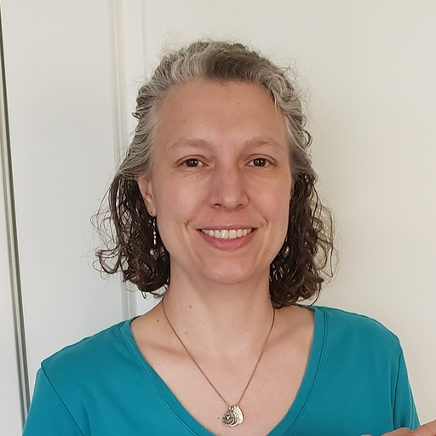


Meet The Team
Project Lead
Frontend Devs
Data Scientists
UI Developers
David Betts
Ismail Al Kamal
Charlie May
Teresa Franxman
Backend Dev
Brian Clayton
Sara West
Shenica Graham
Shomari Roberts
By Shenica r. Graham

Slide 5
Our Story
We are a group of Lambda school students who decided to collaborate and develop an app that would help end failed Kickstarter campaigns. We believe that being able to predict the likelihood of campaign success or failure before investing time, money, and other resources, gives an edge up on the Kickstarter process that can help campaign owners eliminate failure. We used data from hundreds of thousands of Kickstarter campaigns and found trends in campaign categories, fundraising days, goals, and descriptions. We developed a success predictor app to identify projects that were likely to succeed or fail. We launched the Kickstarter Success App and developed a website to allow anyone to use our app for free!
By Shenica r. Graham

Slide 6
About The App
The Kickstarter Success Campaign Predictor (KS) App predicts the likelihood of success of your Kickstarter campaign based on campaign category, fundraising goal, description, and length in terms of how many days the campaign will run. The app returns a campaign prediction of either “success” or “failure.” This information can be used to help determine whether a campaign is viable or not, before investing time, money, and other resources. Our app is available to anyone, free of charge at https://kickstarter-success-1.vercel.app/.
By Shenica r. Graham

Slide 7
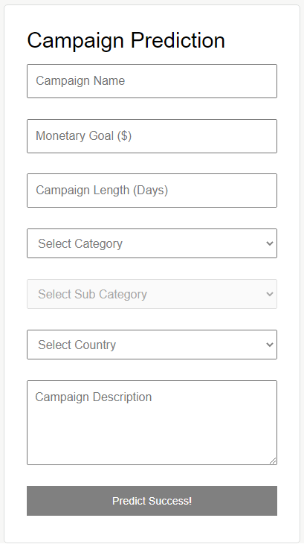
About the App: How It Works
The user must first enter a campaign name, monetary goal, and length of campaign in number of days. Next, the user selects a campaign category and subcategory. Then, the user selects their country of residence. Finally, the user enters a campaign description before clicking the “Predict Success!” button. On this event, the app uses machine learning techniques to analyze past Kickstarter campaign data and compare it to the user’s submitted details. A prediction of either success or failure will be returned.
By Shenica r. Graham

Slide 8
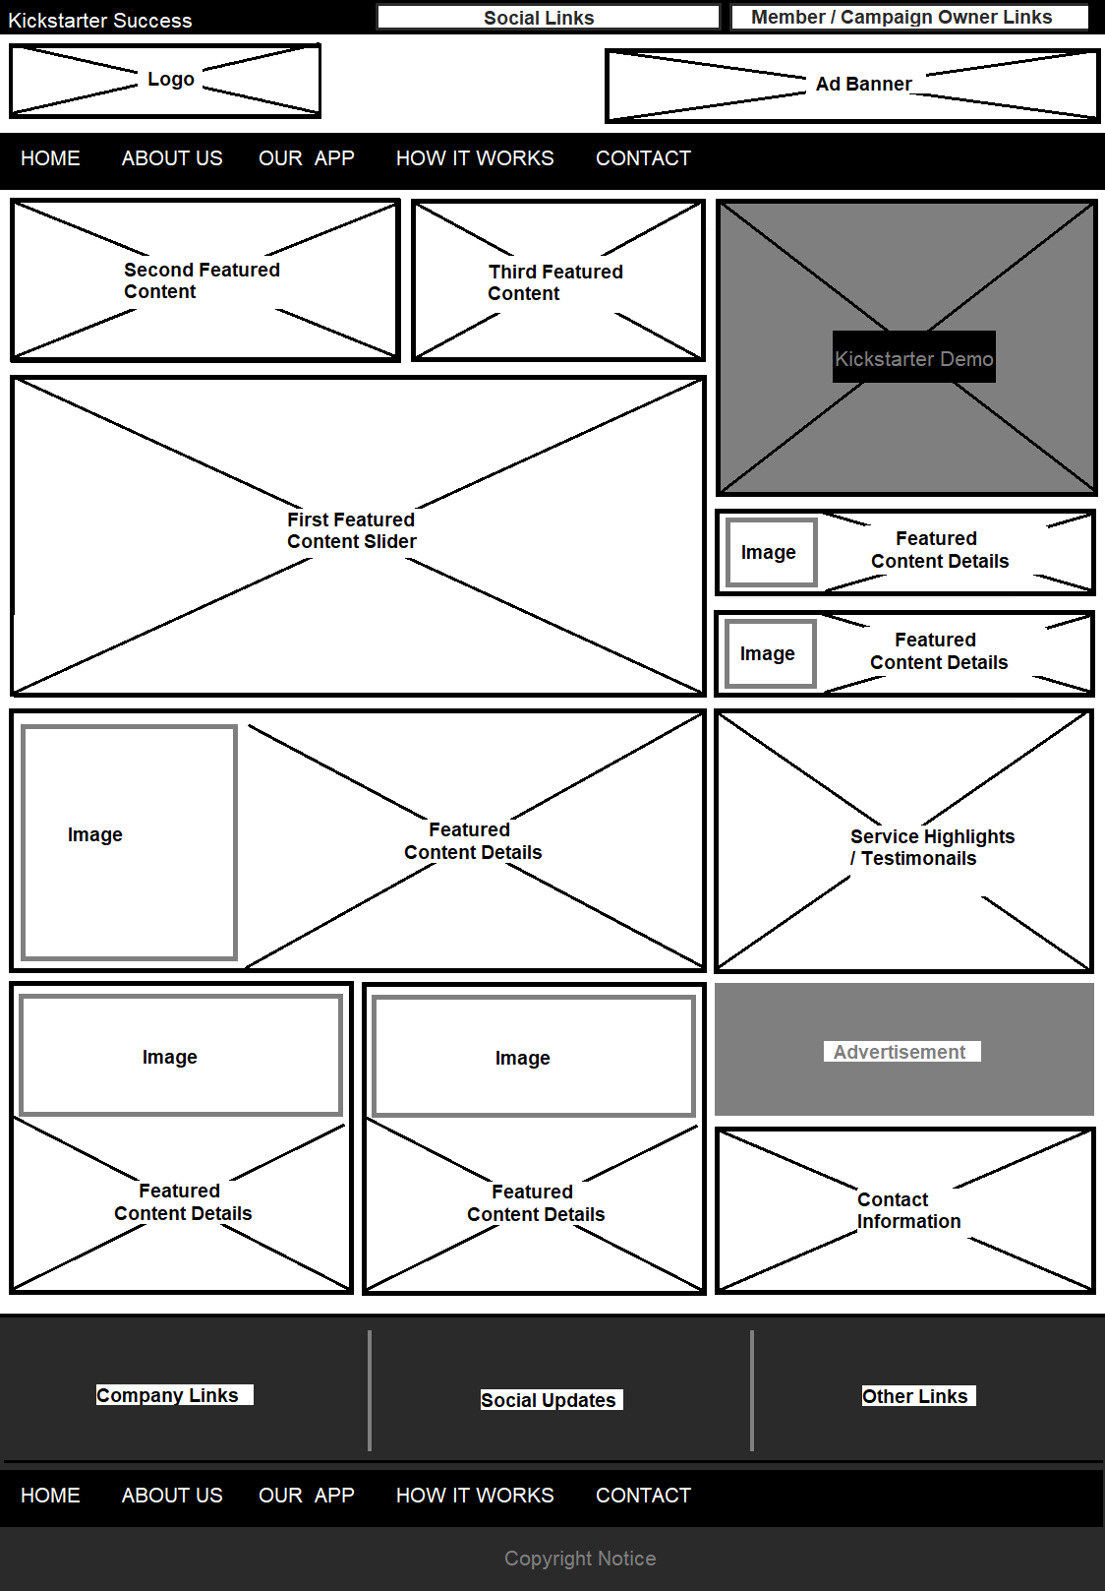
The Website: HTML
Now, let’s look at the website:
Deployed to Netlify
Laid out using semantic tags
Indented and commented
Matches wireframes
Contains robust content and project descriptions
Has a call to action on the home page (Login) that links to the project app.
By Shenica r. Graham

Slide 9

The Website: CSS
CSS is clean, in an external stylesheet
Matches design files
Uses flexbox to achieve the layout
A CSS reset is implemented before custom styles
Scalable units are used throughout for images and large containers
Comments make it easier to read
Helper classes avoid repeating styles
By Shenica r. Graham

Slide 10
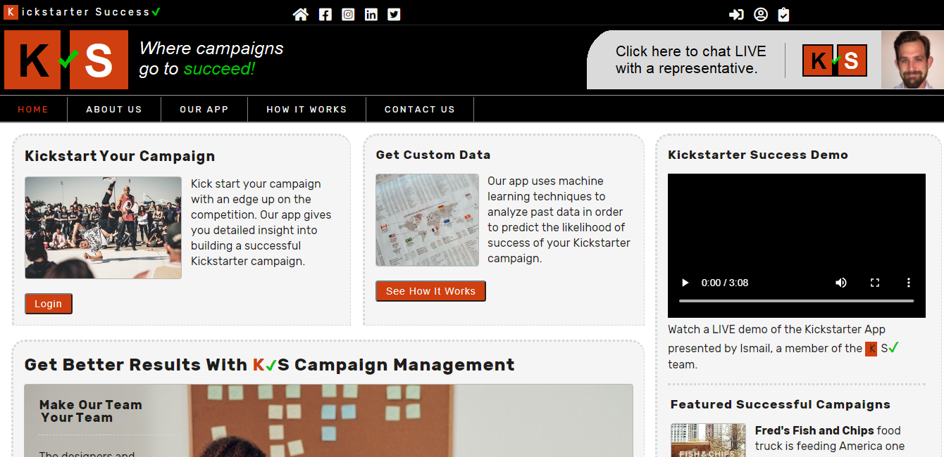
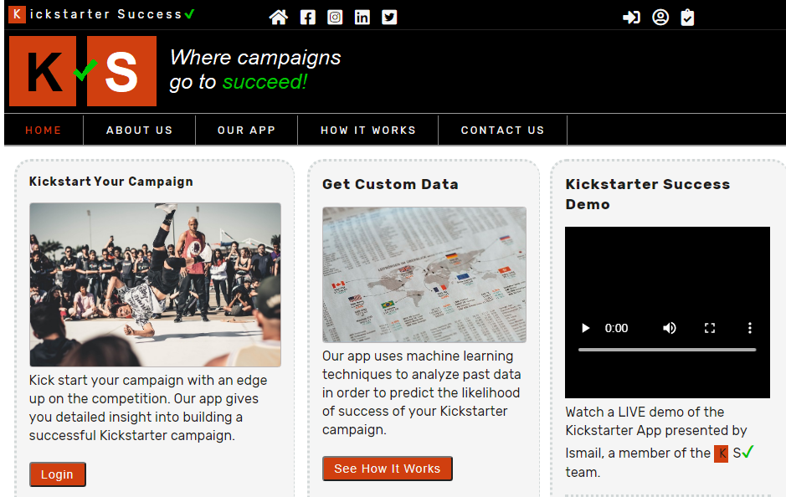
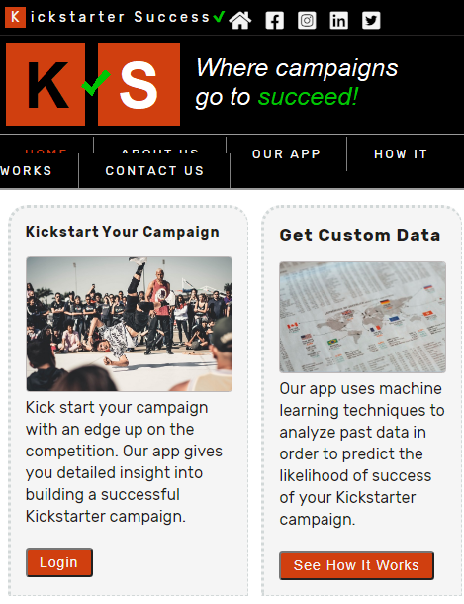
The Website: Responsiveness
Responsive at desktop (1024px), tablet (800px), and mobile (500) breakpoints
Site is appealing between breakpoints due to scalable units.
Media queries added at additional breakpoints if site looks abnormal
Images optimized for fast loading
By Shenica r. Graham

Slide 11
The Website: Accessibility
Semantic elements used as much as possible
Alt attributes contain appropriate image descriptions
Contact form has added labels for each input and “for” attribute matches id in the input
ARIA roles added where needed
By Shenica r. Graham

Slide 12
Summary
The Kickstarter Success Campaign Predictor (KS) App is ideal to predict the likelihood of success of a Kickstarter campaign before you spend time, money, and other resources. Predictions vary based on category, fundraising goal, description, and campaign length in days. This app is available to anyone, free of charge at https://kickstarter-success-1.vercel.app/. The website has well developed HTML and CSS with custom graphics and rich content.
By Shenica r. Graham

Slide 13
Sources
Eggert, Eddi and Abou-Zahra, Shadi. (2019, Jul. 27). Labeling Controls. Web Accessibility Tutorials:
Guidance on how to create websites that meet WCAG. https://www.w3.org/WAI/tutorials/forms/labels/
Kickstarter. (2020, Oct. 25). Stats. https://www.kickstarter.com/help/stats
Mozilla. (2020, Jul. 02). ARIA. https://developer.mozilla.org/en-US/docs/Web/Accessibility/ARIA
Szmigiera, M. (2019, Dec. 11). Kickstarter: distribution of unsuccessfully funded projects 2019. Statista.
https://www.statista.com/statistics/251732/overview-of-unsuccessfully-funded-projects-on- crowdfunding-platform-kickstarter/
By Shenica r. Graham

